Slide 1
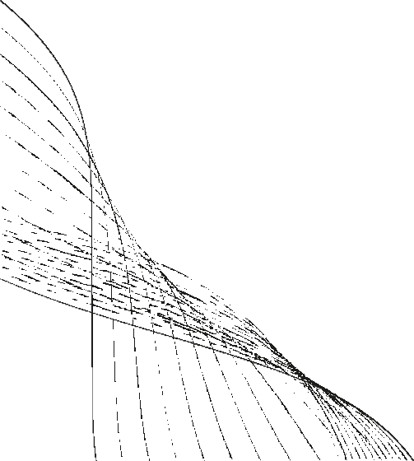
Reading E-Book
PREPARED BY :-
Name: Somani Vansh A.
Roll No. : 258
Er No. : 23002171310167
Branch : CST
Batch : B-09

Slide 2
Project Outline
Introduction
Data base used
Tables Used
Flow-chart Diagram of the System
ER Diagram of the System
Use-Case Diagram
Functionalities of the Project
Data Structures and Tools used
Merits & Demerits
Additional Functionalities
Some example of E-BOOK system

Slide 3
Introduction
The E-Book Reading System is designed to streamline the process of discovering, reading, and managing digital books.
It is a comprehensive platform that not only allows users to read e-books but also helps them organize their reading lists and explore a variety of categories and book options , By integrating advanced database management.
Digital platform for storing, managing and delivering electronics book(E-books).

Slide 4
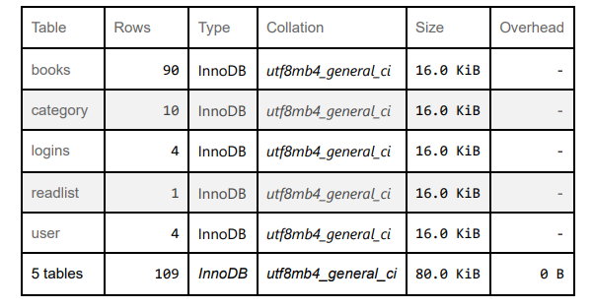
DATA BASE
NAME OF DATA-BASE : E-Book
PARENT TABLES
category
user
CHILD TABLES
Books
Logins
readlist

Slide 5
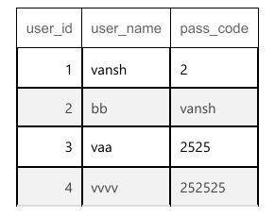
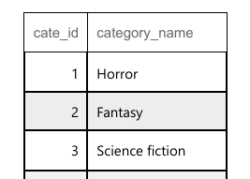
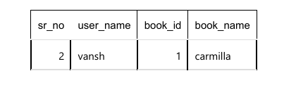
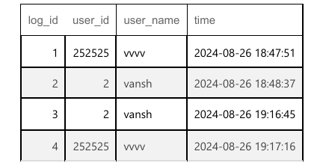
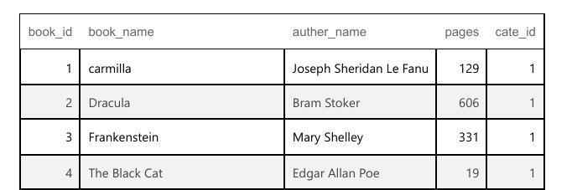
TABLES USED
USER
CATEGORY
READLIST
LOGINS
BOOKS

Slide 6
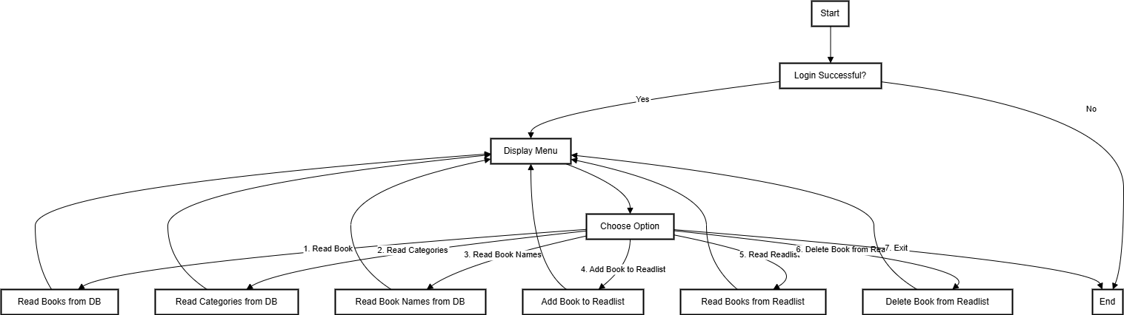
Flow-Chart

Slide 7
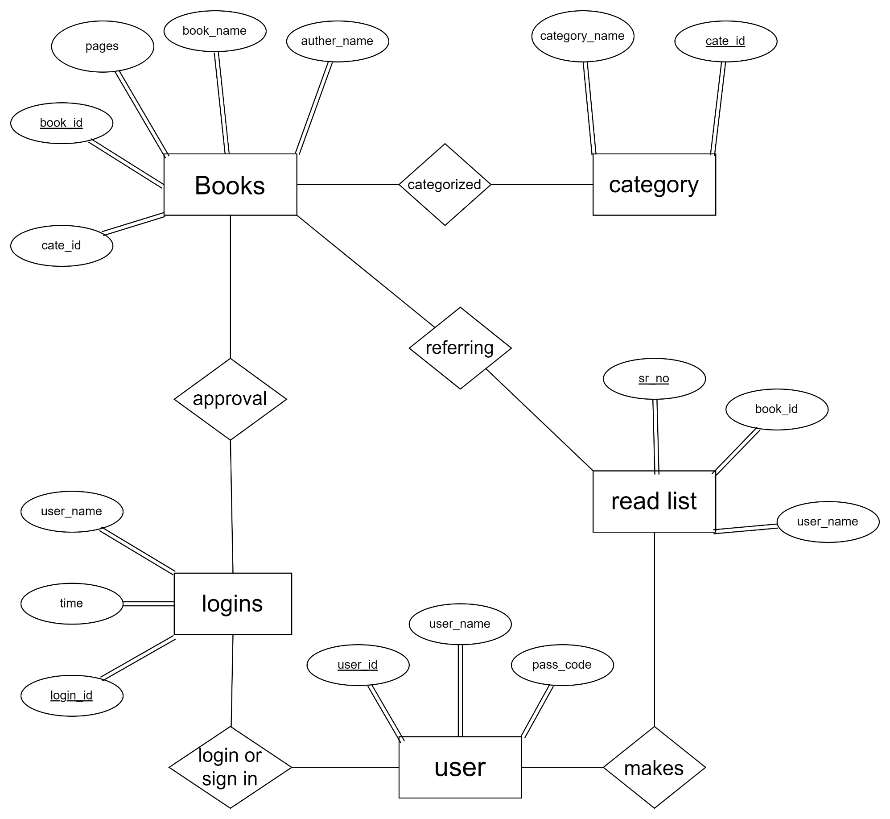
Entity Relationship Diagram
Table names | Primary key(PK) | Foreign key(FK)
1.books | Book_id | Cate_id
2.category | Cate_id | -
3.user | User_id | -
4.login | Log_id | User_id
5.readlist | Sr_no | Book_id

Slide 8
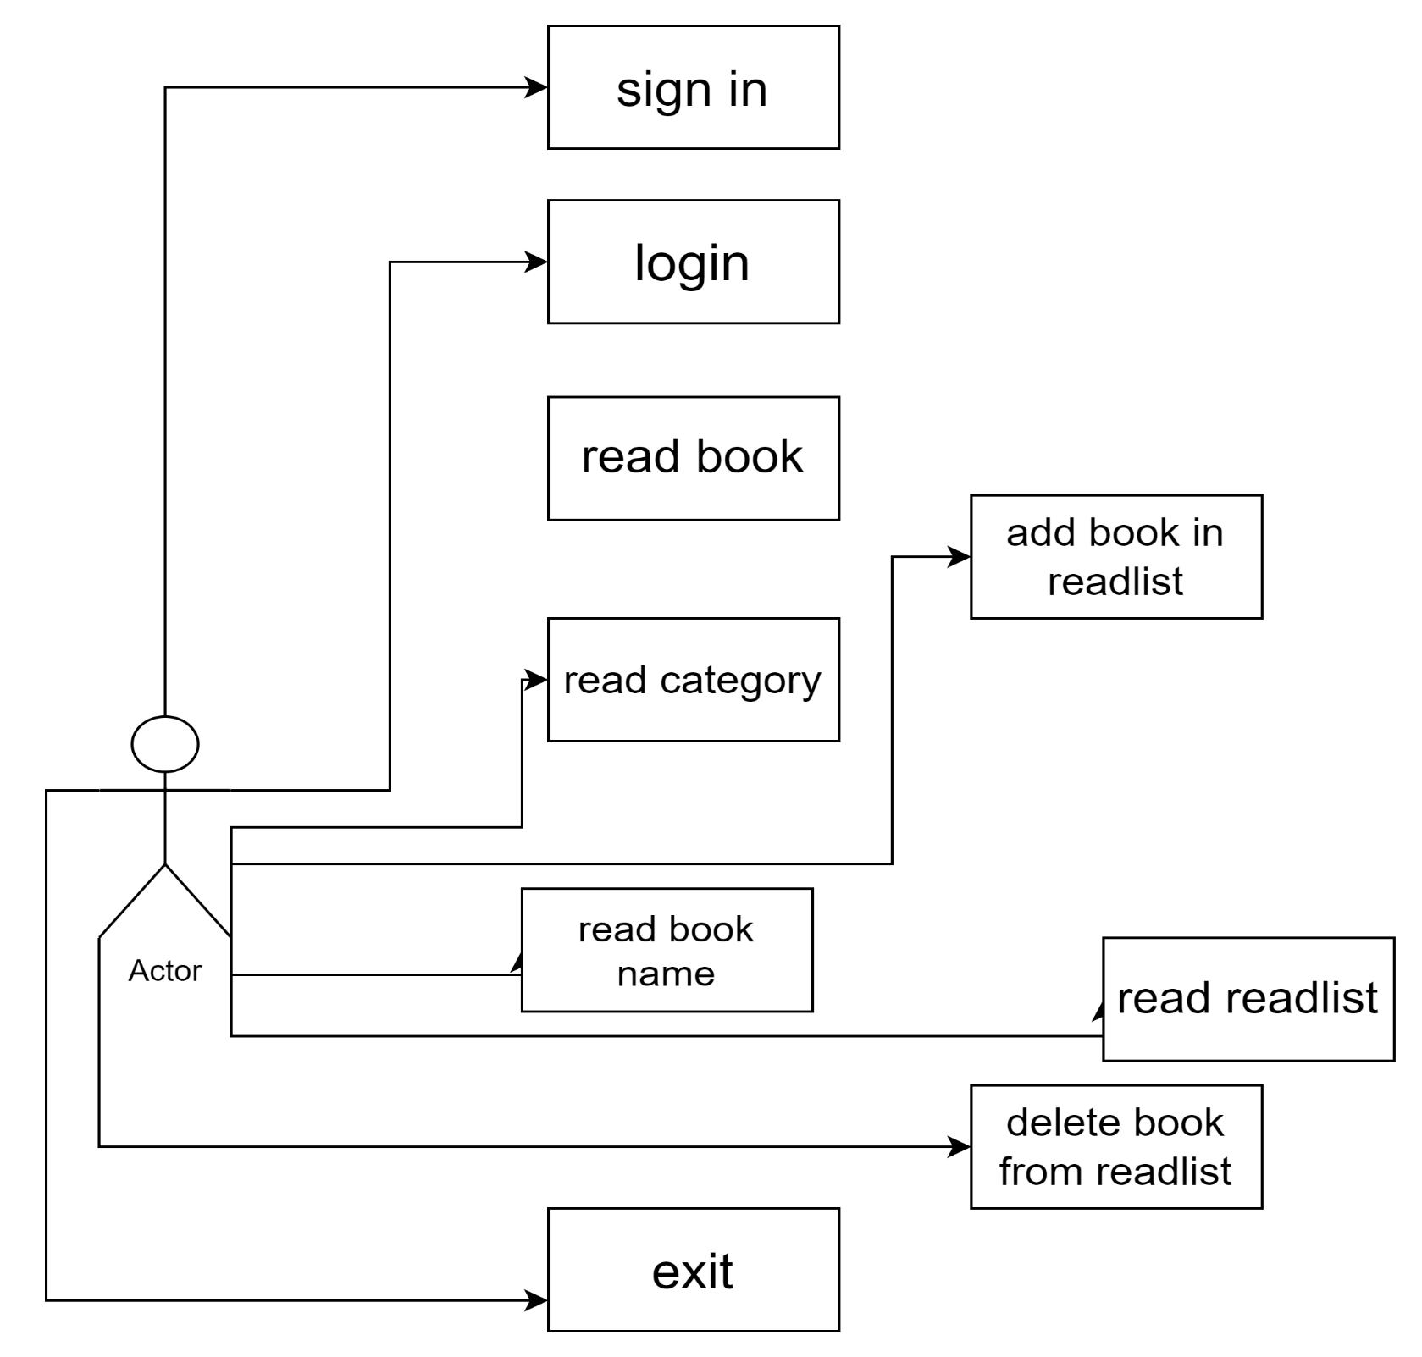
Use-Case Diagram

Slide 9
Functionalities of the project
DATA STRUCTURE USING JAVA | JAVA-II | DATABASE MANAGEMENT SYSTEM
1. Stack oprations using array for add book in readlist. | User Input/Output Handling | 1. Store User ,Books,logins time,categorys details.
2. POP opration use for add readlist data enter in Data-base. | 2. Exception Handling | 2. Manage Read-List.
3. Display Books add by user in readlist. | 3. Database Integration | 3. Retrieve Books details,user logins details.
1)

Slide 10


Data Structures and Tools used
DATASTRUCTURE USED:
Stack(using Array)
TOOLS USED:
VSCODE
MYSQL FOR DATABASE MANAGEMENT SYSTEM
SCANNER CLASS FOR INPUT
SQL CONNECTOR

Slide 11
Merits & Demerits
Merits
Demerits
Comprehensive Book Management System.
2. Multiple Categories.
Book Details.
4. User-Friendly Interface.
Secure Login and Registration.
Readlist Management.
7. Database Integration.
Distracting.
Dependence on technology.
Limited battery life
Compatibility issues

Slide 12
Additional Functionalities
Audio Narration
Page marking
Book oprations
Add
Delete
Download
Video Animation options
Language customization
Progress Tracking
Searching Function

Slide 13






S
Some Examples of E-Book System
Google Docs
Libby
Point Cloud Library

Slide 14
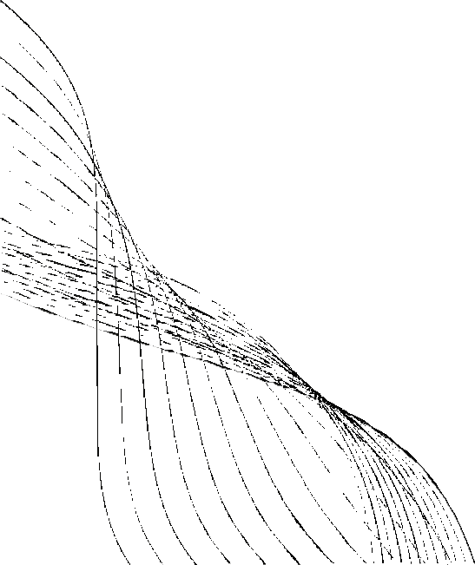
Thankyou!

